Slide 1
Data Cleansing
Maimoona Khilji .

Slide 2
Data Cleansing
It is the process of detecting and correcting
(or removing) corrupt or inaccurate records from a record set, table, or database.
It refers to identifying incomplete, incorrect, inaccurate or irrelevant parts of the data and then replacing, modifying, or deleting the dirty or coarse data.
What a long definition! It is certainly not fun and very time-consuming.
Notes:
It is the process of detecting and correcting
(or removing) corrupt or inaccurate records from a record set, table, or database and
refers to identifying incomplete, incorrect, inaccurate or irrelevant parts of the data and then replacing, modifying, or deleting the dirty or coarse data.
What a long definition! It is certainly not fun and very time-consuming.

Slide 3
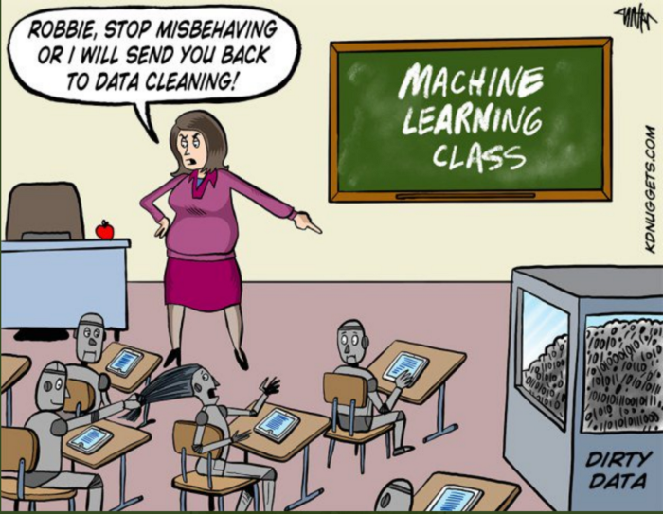

Slide 4
01
02
03
Missing Data
Irregular Data (Outliers)
Unnecessary Data — Repetitive Data, Duplicates
Notes:
To make it easier, we created this new complete step-by-step guide in Python. You’ll learn techniques on how to find and clean:

Slide 5
Missing Data
Missing data, or missing values, occur when you don't have data stored for certain variables or participants. Data can go missing due to incomplete data entry, equipment malfunctions, lost files, and many other reasons.

Slide 6
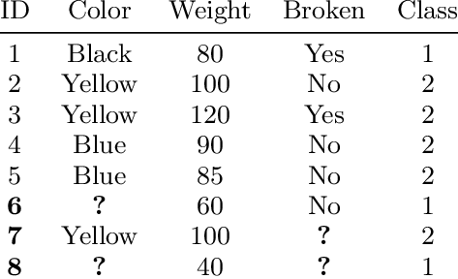
Missing Data

Slide 7
How to find out?
TECHNIQUE I
TECHNIQUE II
TECHNIQUE III
Missing Data Heatmap
Missing Data Percentage List
Missing Data Histogram

Slide 8
Solutions
01
02
03
03
Drop the Observation
Drop the Feature
Impute the Missing
Replace the Missing

Slide 9
Irregular Data (Outliers)
An outlier is an observation that lies an abnormal distance from other values in a random sample from a population.

Slide 10
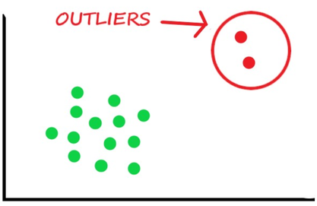
Irregular Data (Outliers)

Slide 11
How to find out?
TECHNIQUE I
TECHNIQUE II
TECHNIQUE III
Histogram/Box Plot
Descriptive Statistics
Bar Chart

Slide 12
Solutions
01
02
03
Drop the Outlier record
Transformation
Impute the Missing

Slide 13
Unnecessary Data — Repetitive Data, Duplicates
All the data feeding into the model should serve the purpose of the project. The unnecessary data is when the data doesn’t add value.

Slide 14
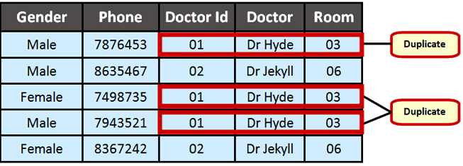
Unnecessary Data — Repetitive Data, Duplicates

Slide 15
Types of unnecessary data
TECHNIQUE I
TECHNIQUE II
TECHNIQUE III
Uninformative / Repetitive
Irrelevant
Duplicates

Slide 16
Solutions
01
02
Drop the irrelevant Feature
Drop these duplicates

Slide 17
Thank you!

